Slide 1
2024 Run/Pass Variability on 3rd/4th and 2 in the NFL:
Why Teams Should Look to Increase Variation for First Down Success Rate
By Peter Chapman

Slide 2
Research Study Overview
2024 NFL season analysis using Pro Football Focus
Situation: 3rd or 4th and 2 on offense
Total attempts and 1st down successes tracked for each team
Play type (run or pass) marked for each attempt
Variation in play type calculated for each NFL team
Research Question: Does variability in playcalling between running and passing on 3rd or 4th and 2 have a relationship with 1st down conversion percentage?

Slide 3
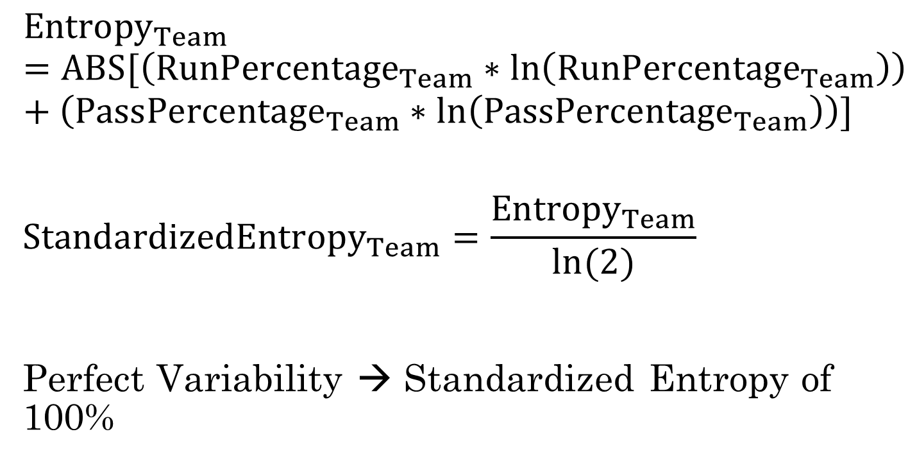
Run/Pass Entropy and Standardized Entropy
$${Entropy}_{Team}=ABS[\left({RunPercentage}_{Team}∗\ln\left({RunPercentage}_{Team}\right)\right)+\left({PassPercentage}_{Team}∗\ln\left({PassPercentage}_{Team}\right)\right)]$$
$${StandardizedEntropy}_{Team}=\frac{{Entropy}_{Team}}{ln⁡(2)}$$
Perfect Variability → Standardized Entropy of 100%

Slide 4
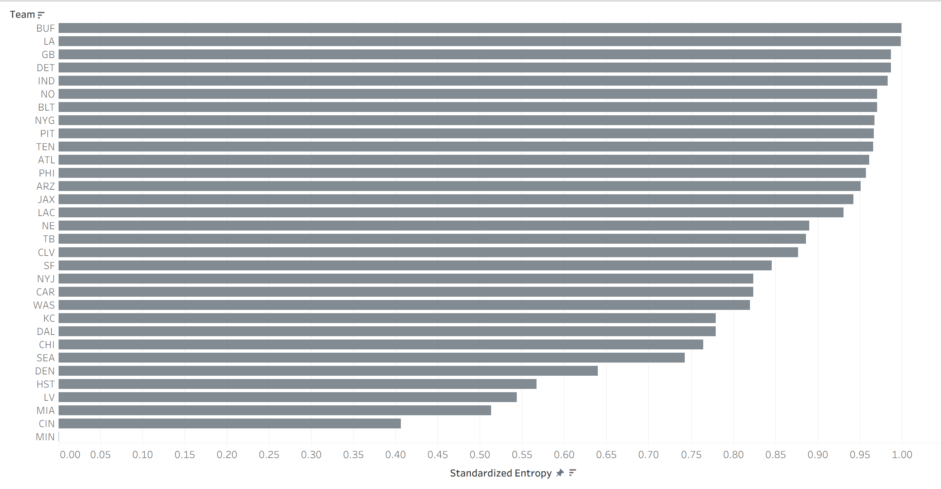
Distribution of Standardized Entropy

Slide 5
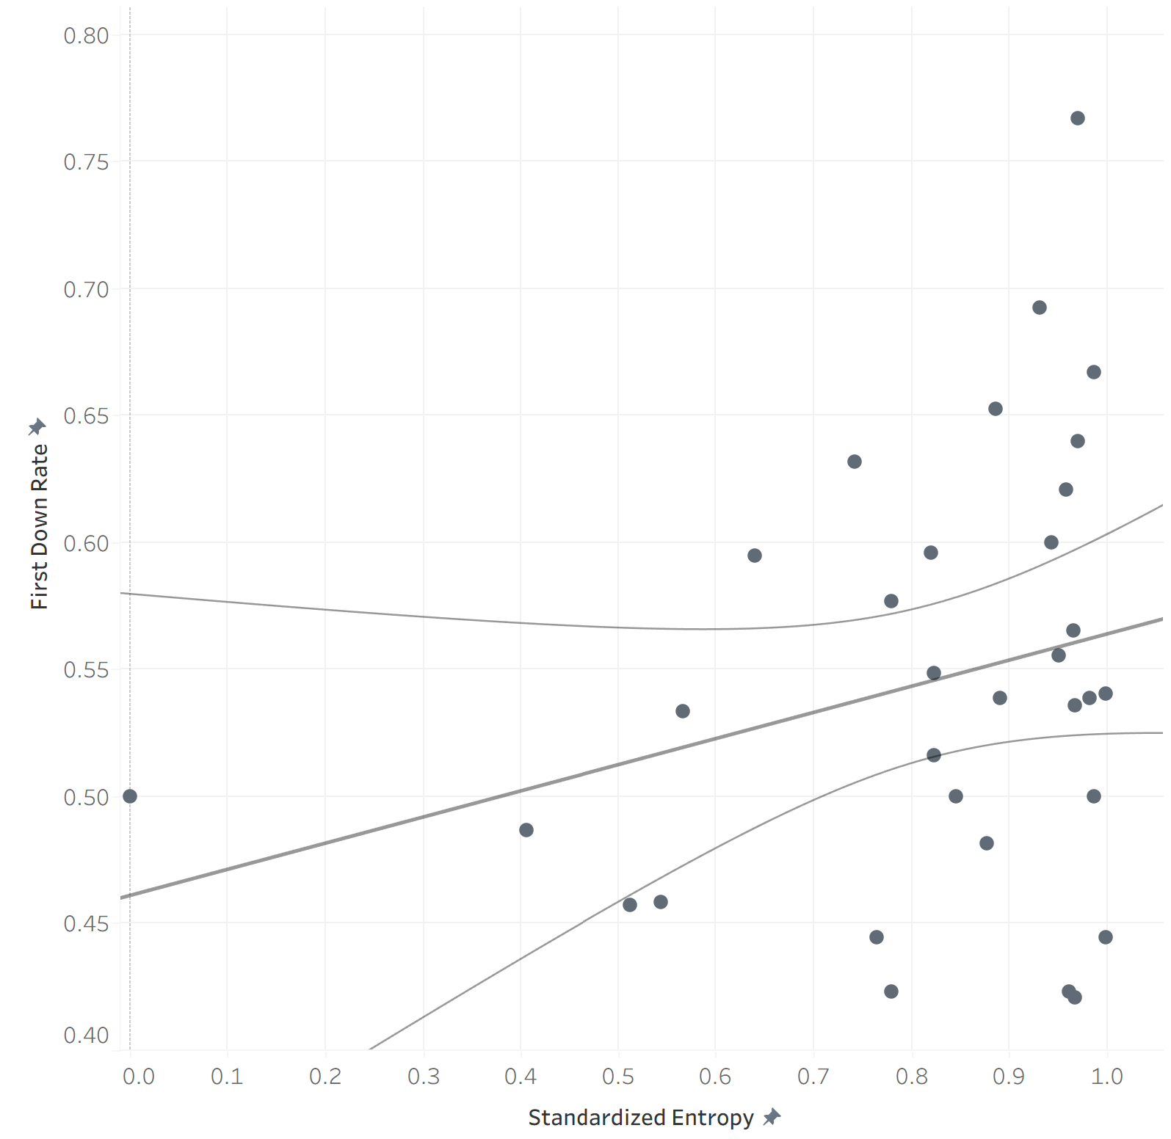

Simple Linear Regression Between Standardized Entropy and 1st Down Rate
$${\hat{FirstDownRate}}_{Team}=0.102944∗{\hat{StandardizedEntropy}}_{Team}+0.460856$$
R-Squared: 6.98%
P-Value: 0.143906

Slide 6
Controlling for Team Offensive Grades
Is playcalling variation on its own truly correlated with 1st down rate?
Lurking variables: Other variables not included in the regression that also have an impact on the dependent variable
Solution: Control for certain team offensive metrics
  Pass Grade
  Pass Block Grade
  Receiving Grade
  Rush Grade
  Rush Block Grade
With controls, true effect of variability on 1st down rate can be determined
Relevant predictors will be kept in the model

Slide 7
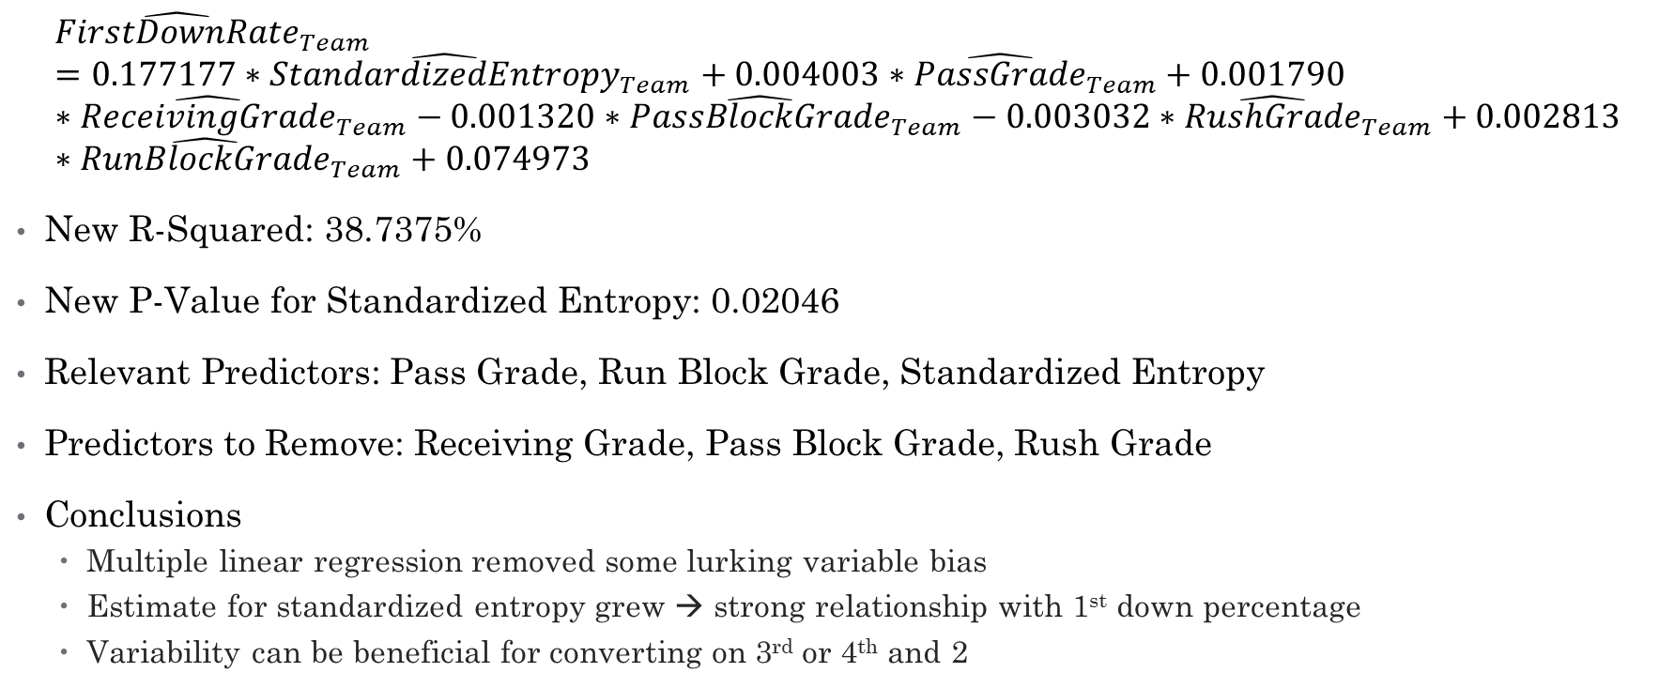
Multiple Linear Regression with Controls
$${\hat{FirstDownRate}}_{Team}=0.177177∗{\hat{StandardizedEntropy}}_{Team}+0.004003∗{\hat{PassGrade}}_{Team}+0.001790∗{\hat{ReceivingGrade}}_{Team}−0.001320∗{\hat{PassBlockGrade}}_{Team}−0.003032∗{\hat{RushGrade}}_{Team}+0.002813∗{\hat{RunBlockGrade}}_{Team}+0.074973$$
New R-Squared: 38.7375%
New P-Value for Standardized Entropy: 0.02046
Relevant Predictors: Pass Grade, Run Block Grade, Standardized Entropy
Predictors to Remove: Receiving Grade, Pass Block Grade, Rush Grade
Conclusions
  Multiple linear regression removed some lurking variable bias
  Estimate for standardized entropy grew → strong relationship with 1st down percentage
  Variability can be beneficial for converting on 3rd or 4th and 2

